Slide 1



Crop and Fertilizer Recommendation System

Slide 2

Learning Objectives
Focuses on machine learning, data preprocessing, and decision tree classification while applying these techniques to agriculture . The learning objectives are divided into different categories to ensure a structured understanding:
Learn about the key soil properties (Nitrogen, Phosphorus, Potassium, pH, Moisture).
Understand climate factors (Temperature, Humidity, Rainfall) affecting crop growth.
Explore crop selection criteria and how different crops require specific soil and environmental conditions.
Learn how fertilizers affect soil quality and crop yield.
Implement a Decision Tree Classifier to predict the best crop based on soil and climate conditions.
GOAL
Source :
www.freepik.com/

Slide 3
Tools and Technology used
Jupyter Notebook (Python 3.11.9) with the following libraries:
Data Handling: NumPy, Pandas
Visualization: Matplotlib, Seaborn
Machine Learning (sklearn):
Preprocessing: LabelEncoder, StandardScaler
Model Selection: train_test_split
Decision Tree Model: DecisionTreeClassifier

Slide 4
Methodology
Follows a structured machine learning workflow to process data, analyze patterns, train a model, and make recommendations for both crop selection and fertilizer recommendations:
1. Using libraries :
First step is to import the necessary Python libraries. Each library serves a specific purpose:
NumPy: Helps with numerical computations.
Pandas: Used for handling datasets in the form of Dataframes.
Matplotlib & Seaborn: Visualization libraries to analyze data trends.
Sklearn (Scikit-learn): Provides tools for data preprocessing, model training, and evaluation.
2. Load the Dataset :
Load the dataset containing information about soil parameters, environmental conditions, and crop types. The dataset is stored as a CSV file, which we read using Pandas.
3. Checking for missing values :
Missing values in the dataset can lead to inaccurate model predictions. We check for missing values and handle them by either removing or filling them using statistical techniques like mean, median, or mode.

Slide 5
4 . Exploratory Data Analysis (EDA) :
EDA helps us understand the data distribution, identify patterns, and detect anomalies. We analyze statistical summaries ((mean, min, max, standard deviation) and visualize key features(A histogram showing the distribution of Nitrogen values across different samples).
5 . Data Visualization (Heatmap for Feature Correlation) :
A heatmap helps us visualize the correlation between different features. High correlation between features indicates strong relationships that may influence crop selection.
A heatmap where:
Values closer to 1 indicate a strong positive correlation.
Values closer to -1 indicate a strong negative correlation.
Values near 0 indicate no correlation.
6 . Machine Learning Model (Decision Tree Classifier) :
We use a Decision Tree Classifier to predict the best crop based on soil and environmental conditions. Before training, we preprocess the data by encoding categorical variables(Label Encoder) and standardizing numerical features.

Slide 6
7 . Model evaluation :
To assess model performance, we calculate accuracy.
Accuracy : 98.18
8 . Prediction :
We create a function where users can input soil and environmental parameters, and the model recommends the best crop and fertilizer.

Slide 7
Problem Statement:
Agriculture is a backbone of many economies, and efficient crop production relies upon several factors such as nutrients in the soil, weather conditions, and proper fertilizers.
Most farmers struggle to select the appropriate crop for their land and fertilizers, which leads to low yields, soil degradation, and financial losses.
This project aims at developing a Crop and Fertilizer Recommendation System by using machine learning:
It recommends the best crop suitable for soil nutrients (N, P, K), pH, temperature, humidity, and rainfall.
It suggests the best fertilizer according to soil moisture, temperature, nutrient level, and type of crop.
Output :
Intelligent decision support system to help farmers in making correct decisions
Optimization of fertilizers for better health of soil and productivity
Sustainable agriculture with less damage to the environment through improper fertilization.

Slide 8
Solution:
1. Crop Selection Based on Soil and Environmental Conditions :
The system uses a Decision Tree Classifier model that takes key features such as N (Nitrogen), P (Phosphorus), K (Potassium), temperature, humidity, pH, and rainfall to predict the most suitable crop. By analyzing these features, the model identifies patterns and recommends crops that are best suited for the given conditions.
Benefits :
Saves time and resources by eliminating trial and error in crop selection.
Maximizes crop yield by recommending crops that are well-adapted to local conditions.
2 . Fertilizer Recommendations to Optimize Crop Growth :
Also provides fertilizer recommendations based on crop needs, soil health, and environmental conditions. By analyzing the soil's moisture, temperature, nutrient levels (N, P, K), and crop type, the model suggests the best fertilizer to improve crop health.
Fertilizer recommendations are made using machine learning techniques, trained on historical data to identify which fertilizers have been most effective under similar conditions.
Benefits:
Ensures efficient use of fertilizers, which helps improve soil fertility without overusing chemicals.
Promotes environmental sustainability by reducing excess fertilizer runoff into water systems.

Slide 9
3. Data-Driven Insights for Better Decision Making :
Provides data-driven insights, allowing farmers to base their decisions on evidence and predictive analytics rather than assumptions . Helps farmers move toward precision agriculture, improving both profitability and environmental sustainability.
Benefits:
Provides actionable insights that can significantly improve farming practices.
Helps farmers move toward precision agriculture, improving both profitability and environmental sustainability.
Reduces the reliance on guesswork or advice from unverified sources.
4.Reducing Environmental Impact :
It recommends fertilizers in the right amounts based on the soil and crop needs, reducing the chances of over-fertilization and its harmful environmental effects.
Helps in reducing environmental pollution from excess fertilizers.
Benefits:
Helps in reducing environmental pollution from excess fertilizers.
Supports soil conservation by suggesting fertilizers that match the soil’s current nutrient levels.

Slide 10
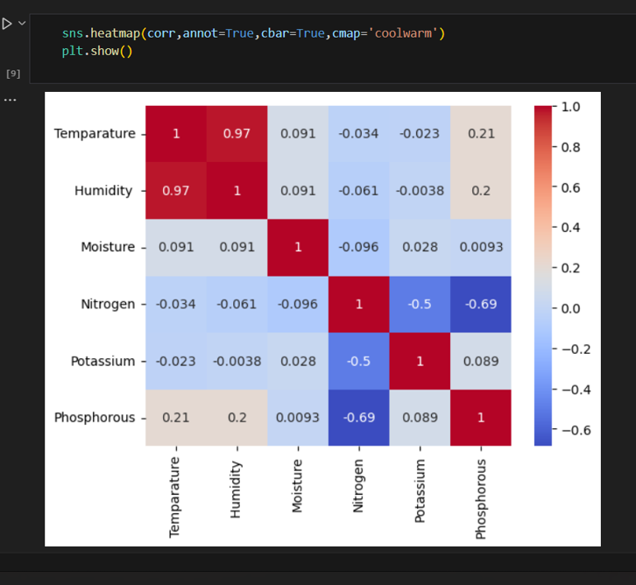
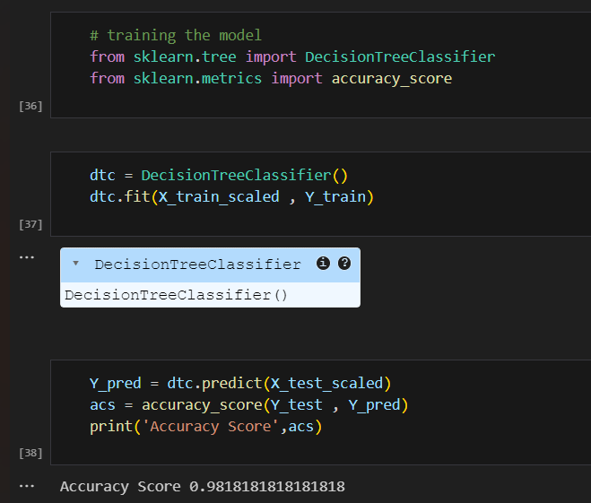
Screenshot of Algorithm :

Slide 11
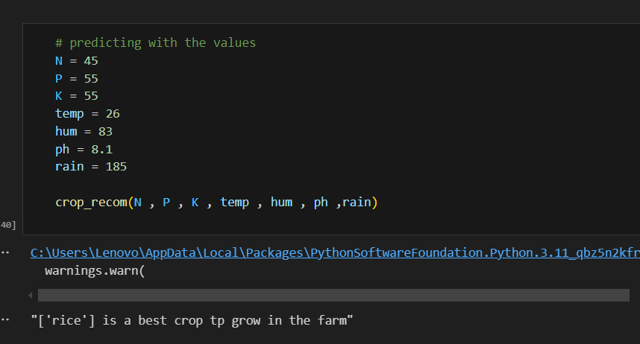
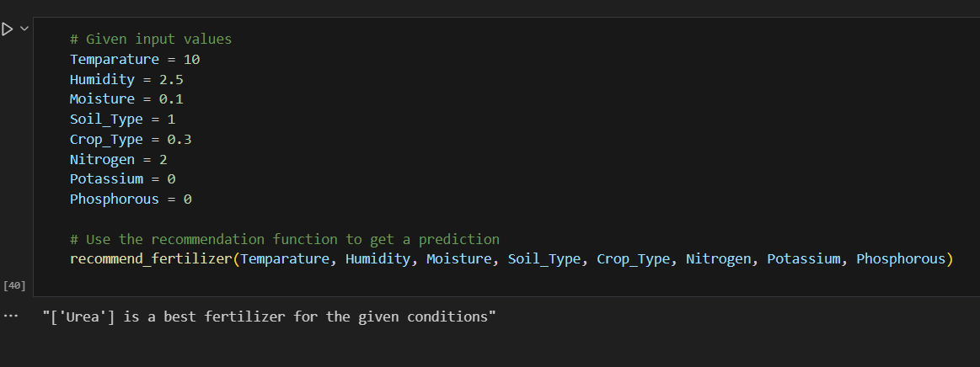
Screenshot of Output :

Slide 12
Conclusion:
A powerful tool that leverages machine learning to address some of the challenges by incorporating data from soil health, environmental conditions, and crop-specific needs, the system provides actionable, data-driven insights that optimize crop selection and fertilizer usage.
Increased Sustainability:
By reducing fertilizer runoff and soil degradation, the system contributes to environmental sustainability, ensuring that farming practices are more aligned with ecological balance.
Economic Benefits for Farmers:
The recommendations lead to better crop yields, reduced fertilizer costs, and more efficient farming practices, increasing profitability for farmers and ensuring more sustainable income streams.
Integration with IoT sensors and smart farming tools could enable the system to provide real-time recommendations, making it even more impactful and adaptive to dynamic agricultural conditions.
Replacing Decision Tree with Random Forest can reduce overfitting and increases stability.
Boosting methods (like XGBoost) provide even higher accuracy for large agricultural datasets.
This approach enhances precision agriculture, helping farmers make better decisions with data-driven insights.

